Slide 1
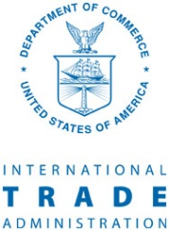
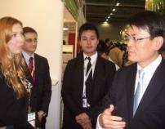
MDCP public-private partnership
Trade associations
Chambers of commerce
State trade departments
Other non-profits
ITA .
MDCP encourages industry groups to partner with ITA
By helping one cooperator, many small- and medium-size enterprises (SMEs) in an industry become more globally competitive
Each MDCP project team includes ITA and other federal specialists who work shoulder-to-shoulder with a cooperator
Cooperators are export multipliers: industry groups that do not export, but whose companies or business constituents do export
SMEs export
Targeted
foreign
markets
Cooperator

Slide 2
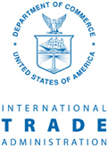
Market Development Cooperator Program (MDCP)
Trade associations
Chambers of commerce
State trade departments.
Other non-profits
ITA .
Evaluation Criteria
20% Potential to generate exports that . . . . . create or sustain U.S. jobs
20% Export performance measurement
20% ITA partnership & priorities
24% Creativity & institutional capacity
16% Budget, match, sustainability
Non-profit industry groups compete for MDCP awards from ITA:
☒ Up to $300,000
☒ Partner w/federal agenciesen
☒ Applications due: en
“Cooperators” commit to:
☒ Projects to engage small
. firms in exporting
☒ Term: 3-5 years
☒ Two-thirds of total cost
Report
export
results
Project-generated exports per $1 of MDCP award
Other federal
agencies
$1
$347
Cooperator
Office of Planning,
Coordination
& Management (OPCM)
I&A
Industry & Analysis
GM
Global Markets
Report
export
results
Joint team coordination
Targeted
foreign
markets
Foreign trade show
Industry standards
Foreign rep office
Product demo center
Trade mission
Technical seminar
Project activities help
small U.S. firms export
SMEs export

Slide 3
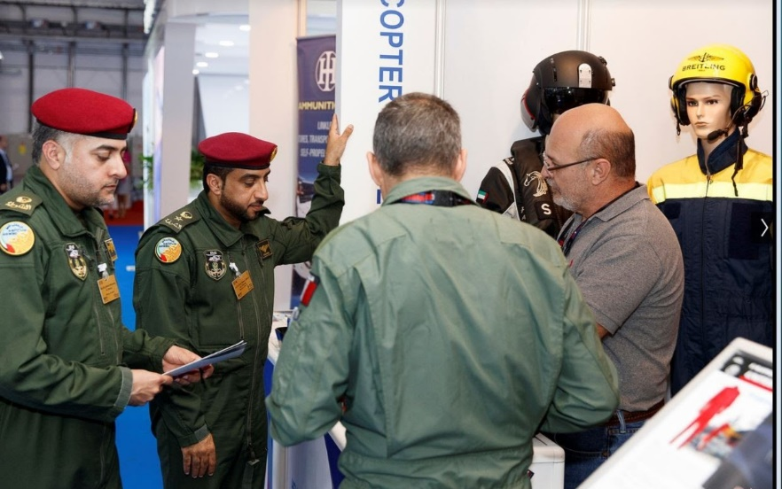
MDCP project example: aerospace products to UAE
Aircrew gear Washington Department of Commerce (WDOC) realized that many firms that have competitive aerospace products find the initial cost of competing for international contracts to be too expensive. In order to get such firms "over the hump", WDOC provides “Aerospace Accelerator Vouchers” to offset some of the cost of participating in trade shows, trade missions and other events. In three years of project activity WDOC helped 30 U.S. firms exports valued at $170 m.
Potential buyers visit the booth of a WDOC-supported U.S. firm at the Dubai Air Show.

Slide 4
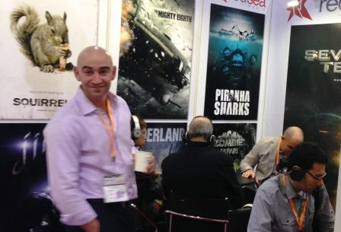
MDCP project example: movie distributors in Hong Kong
Signing film distribution deals at Hong Kong Filmart Commercial Service (CS) Hong Kong, part of ITA's Global Markets business unit, and the International Film and Television Alliance (IFTA) organized an American Pavilion featuring U.S. film distribution and production companies. The pavilion was something that IFTA, representing the U.S. industry, had not been able to do prior to receiving a $127,058 MDCP award from ITA.
International buyers at the Hong Kong International Film and TV Market (Filmart) don headphones to sample entertainment offerings of a California-based film production and distribution company. By the show’s end, 21 U.S. exhibitors reported closing 89 deals with buyers in 16 countries totaling $7.5 million.

Slide 5
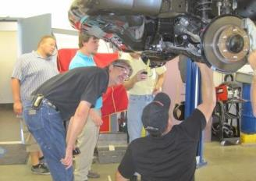
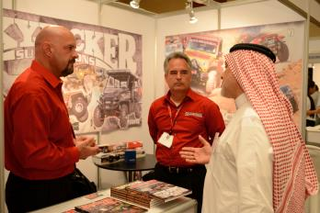
MDCP project example: specialty auto equipment to Gulf States & China
Measuring session & trade shows ITA is helping the Specialty Equipment Market Association (SEMA) boost export to the Gulf States and to China. Rules on what is “street-legal” and who is authorized to customize a vehicle, e.g. vehicle manufacturer or local auto shop, are issues SEMA is addressing with ITA’s help.
U.S. specialty auto equipment makers measure a Toyota Hi-Lux 4x4 truck. ITA helped SEMA get special permission to import this truck temporarily in the United States. The vehicle is not authorized for U.S. sale but is the highest selling vehicle worldwide that is likely to be customized. As result, more than 200 U.S. manufacturers created export-ready products for customers abroad.

Slide 6
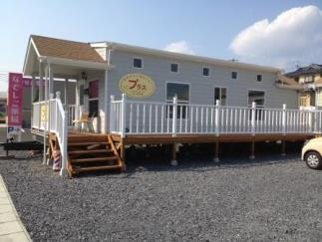
MDCP project example: RVs in China, Japan, Korea
Temp Solution for Perms The Recreation Vehicle Industry Association (RVIA) received $300,000 in MDCP. One year into the project, RVIA has now hired a full-time representative who lives and works in East Asia. The project has generated several million dollars of exports. Sales measured in hundreds of millions of dollars per year are on the horizon, especially in China, but not until China addresses standards and regulatory issues. Through the MDCP project, ITA is helping RVIA remove barriers.
RVIA helped a member company sell this temporary beauty shop that replaces one destroyed in the recent tsunami.

Slide 7
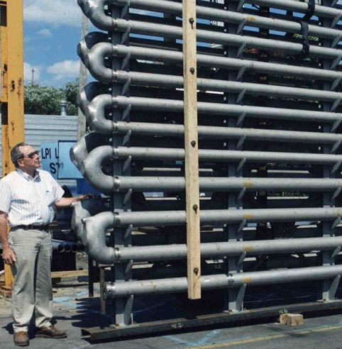
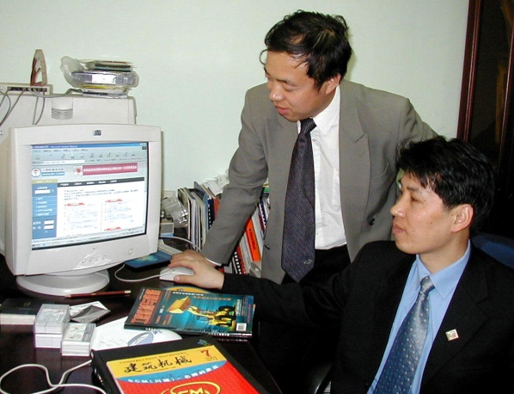
MDCP project examples:
Steel products to Europe
Construction equipment to China
SFSA’s MDCP project activity in the International Organization for Standardization (ISO) helped U.S. makers of various steel products increase exports by $129 m.
AEM leveraged an MDCP award to open a Beijing office from which its staff reviews trade journals for construction bid opportunities in China and makes them available to AEM members via its website

